Slide 1
Security and Usability Analysis of Covid19 contact Tracing apps
By: Nishit Patel, David Cancel

Slide 2










Introduction
Problem Statement:
Static profiling of Android Covid19 contact tracing apps to identify:
Potential privacy-invasion.
Study app config for vulnerabilities and weaknesses.
Analyze the usability and effectiveness of the apps from a user perspective.
Solution:
Scrutinize each app using Android reverse engineering tool Androguard for:
Sensitive permissions, API call involving end-user privacy.
Common Weakness Enumerations (CWEs), Common Vulnerabilities and Exposures (CVEs).
Scrape user reviews of each app from the Playstore and classify the reviews to identify user sentiment.

Slide 3

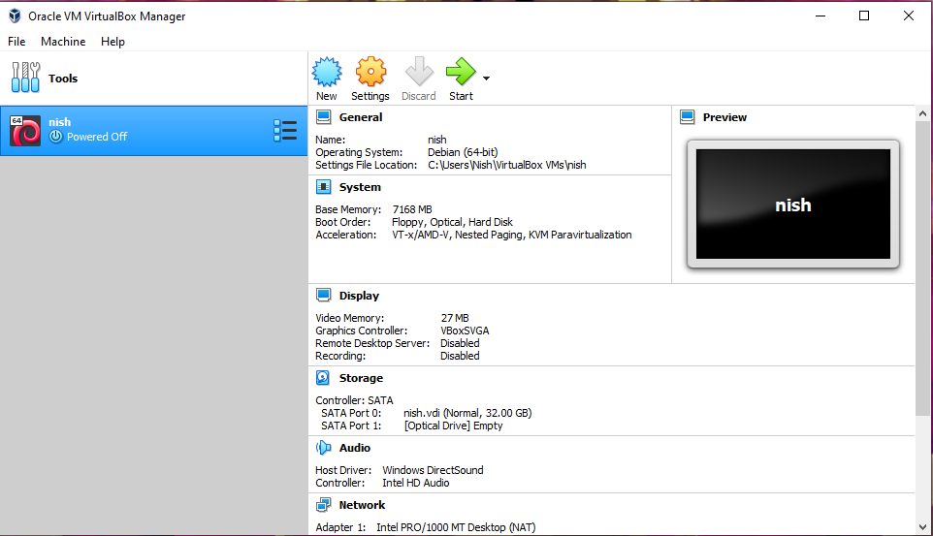
Security Analysis: Approach
VirtualBox is a virtualization product which lets us run any software on it. In this case we will use Kali Linux and load the iso file into the storage and it will recognize it as our primary boot.

Slide 4

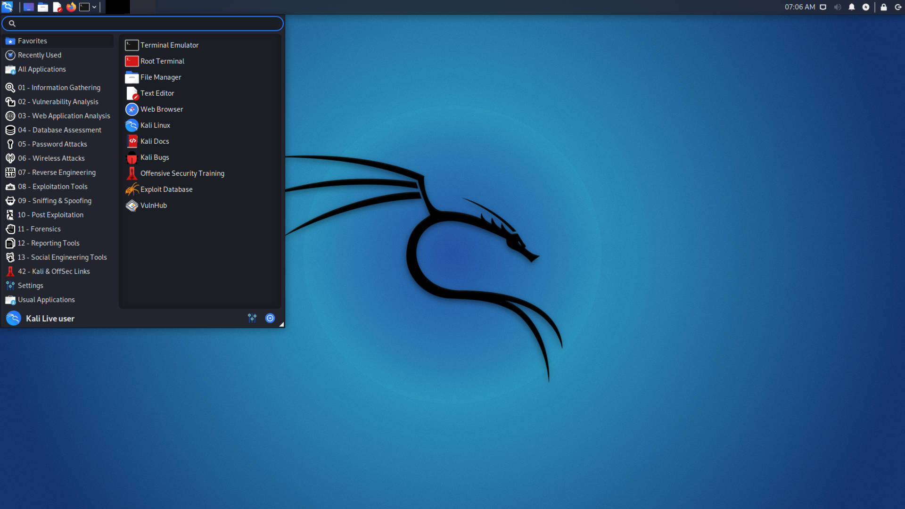
What is Kali Linux?
Kali Linux is an open-source, Debian-based Linux distribution geared towards various information security tasks, such as Penetration Testing, Security Research, Computer Forensics and Reverse Engineering.

Slide 5

What is Androguard?
Androguard is a Python-based tool used for reverse engineering Android apps. This entails taking the raw Android Package (.apk) files of the app and breaking them down to analyze.
This tool is necessary for penetration testing and vulnerability analysis.
Procedure:
Install, update, and upgrade Kali Linux
Install Androguard
Open Terminal
Start Androguard

Slide 6
Androguard Analysis Code
In [7]: a.get_androidversion_code()
Out[7]: '2162'
In [8]: a.get_androidversion_name()
Out[8]: '0.62'
In [9]: a.get_min_sdk_version()
Out[9]: '21'
In [10]: a.get_max_sdk_version()
In [11]: a.get_target_sdk_version()
Out[11]: '27'
In [12]: a.get_effective_target_sdk_version()
Out[12]: 27
$ androguard analyze
Androguard version 3.1.1 started
In [1]: a, d, dx = AnalyzeAPK("examples/android/abcore/app-prod-debug.apk")
# Depending on the size of the APK, this might take a while...
In [2]:
In [2]: a.get_permissions()
Out[2]:
['android.permission.INTERNET',
'android.permission.WRITE_EXTERNAL_STORAGE',
'android.permission.ACCESS_WIFI_STATE',
'android.permission.ACCESS_NETWORK_STATE']
In [3]: a.get_activities()
Out[3]:
['com.greenaddress.abcore.MainActivity',
'com.greenaddress.abcore.BitcoinConfEditActivity',
'com.greenaddress.abcore.DownloadActivity']
In [4]: a.get_package()
Out[4]: 'com.greenaddress.abcore'
In [5]: a.get_app_name()
Out[5]: u'ABCore'
In [6]: a.get_app_icon()
Out[6]: u'res/mipmap-xxxhdpi-v4/ic_launcher.png'

Slide 7
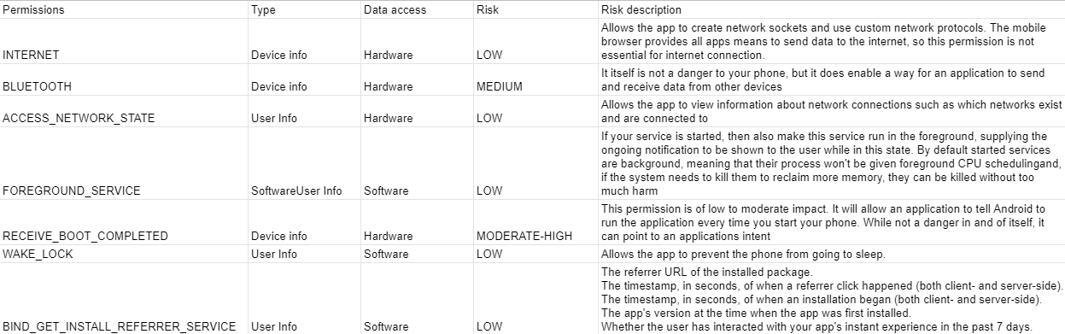
Androguard Analysis: Vulnerabilities
Sources:
https://developer.android.com/reference/android/Manifest.permission
https://source.android.com/security/bulletin/2021-01-01
Device info: OS Version, Device, Model, API level, Firmware Version and so on more info: https://developer.android.com/reference/android/os/Build.html
User info: Last Name, First Name, Email, ID, Profile Photo. More info: https://developers.google.com/identity/sign-in/android/people

Slide 8
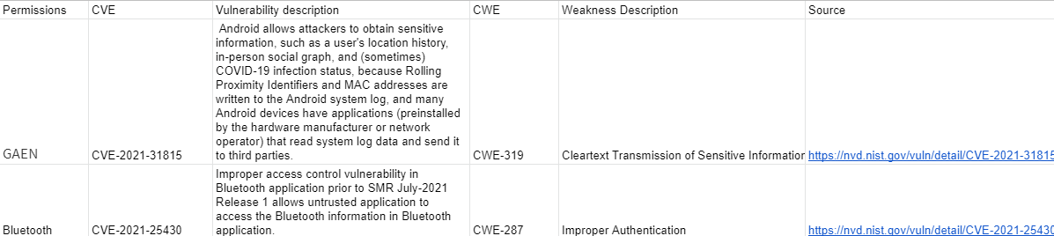
Androguard Analysis: Vulnerabilities (Cont.)
Sources: https://cve.mitre.org/cgi-bin/cvename.cgi?name=CVE-2021-25430
https://cve.mitre.org/cgi-bin/cvename.cgi?name=CVE-2021-31815

Slide 9
Part 2 - Sentiment Analysis & Prediction using Word Clouds & Logistic Regression

Slide 10
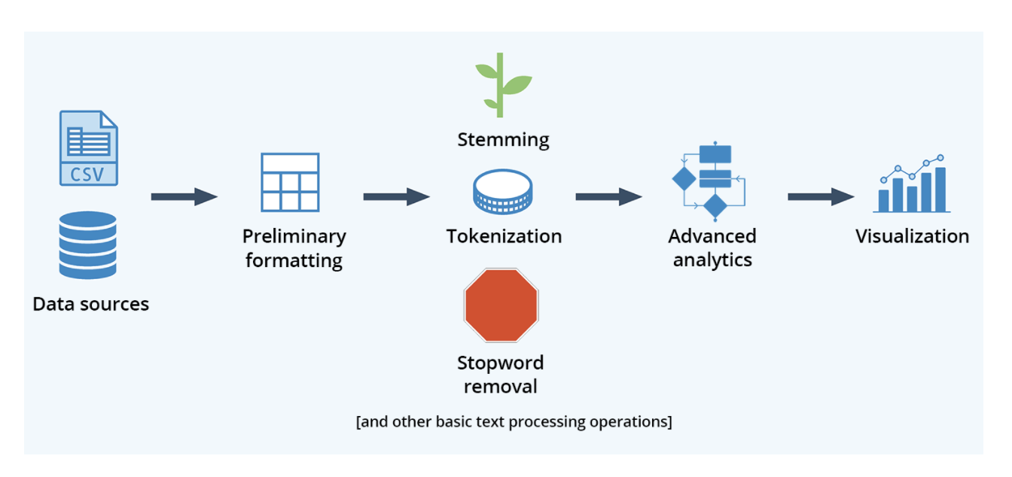
Approach to Sentiment Analysis
Objective:
Our objective is to use text processing and sentiment analysis to predict the Covid tracing apps reviews through reviews on the google play store.
We will achieve this by creating a sentiment algorithm to assign positive negative values to significant words that are frequently used by the consumers. We will use logistic regression as our main method.
Logistic regression allow us to split data and test values with the data we have from the frequently used words with significance.
https://krakensystems.co/blog/2018/nlp-syntax-processing

Slide 11
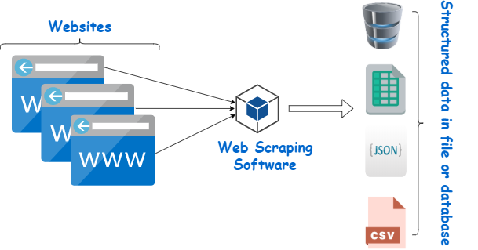
Web Scraping
Web Scraping is the process of using bots to extract content and data from a website.
We wrote code in python to extract the review data from apps on the google play store.
Sources: https://www.webharvy.com/articles/what-is-web-scraping.html

Slide 12
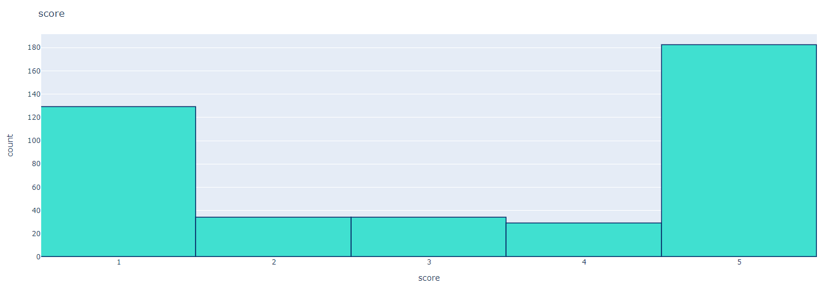
App Score Sentiment
import plotly.io as pio
pio.renderers.default = 'colab'
fig = px.histogram(df, x="score")
fig.update_traces(marker_color="turquoise",marker_line_color='rgb(8,48,107)', marker_line_width=1.5)
fig.update_layout(title_text='score')
fig.show()
Ex.
# assign reviews with score > 3 as positive sentiment
# score < 3 negative sentiment
# remove score = 3
df = df[df['score'] != 3]
df['sentiment'] = df['score'].apply(lambda rating : +1 if rating > 3 else -1)
...

Slide 13
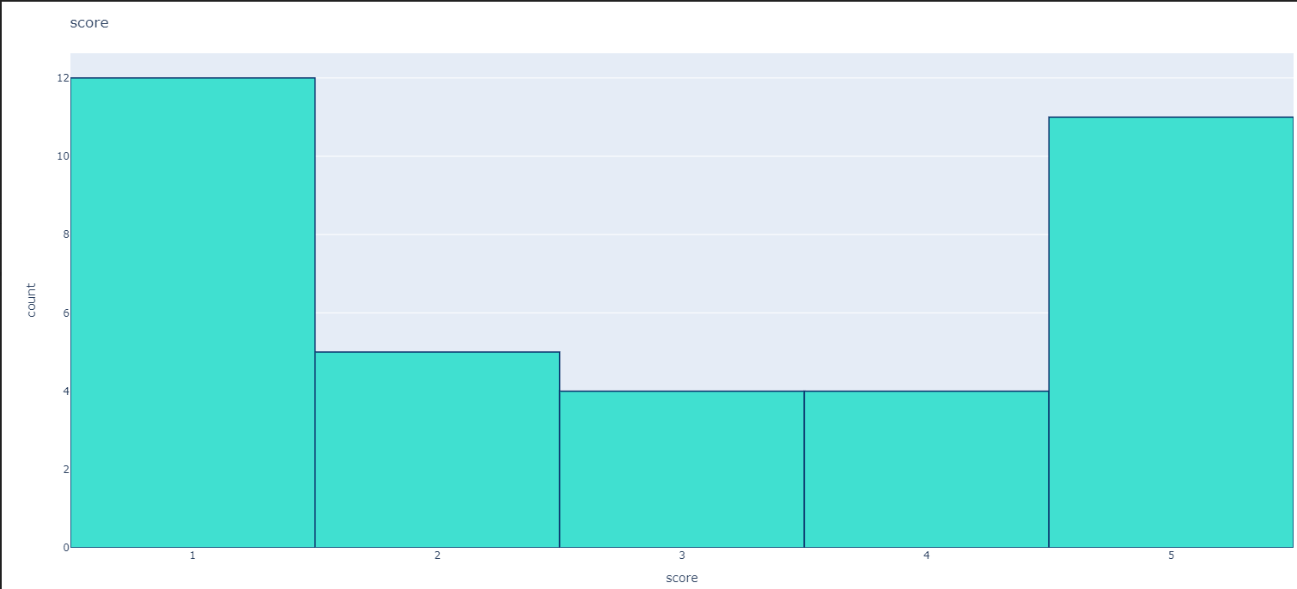
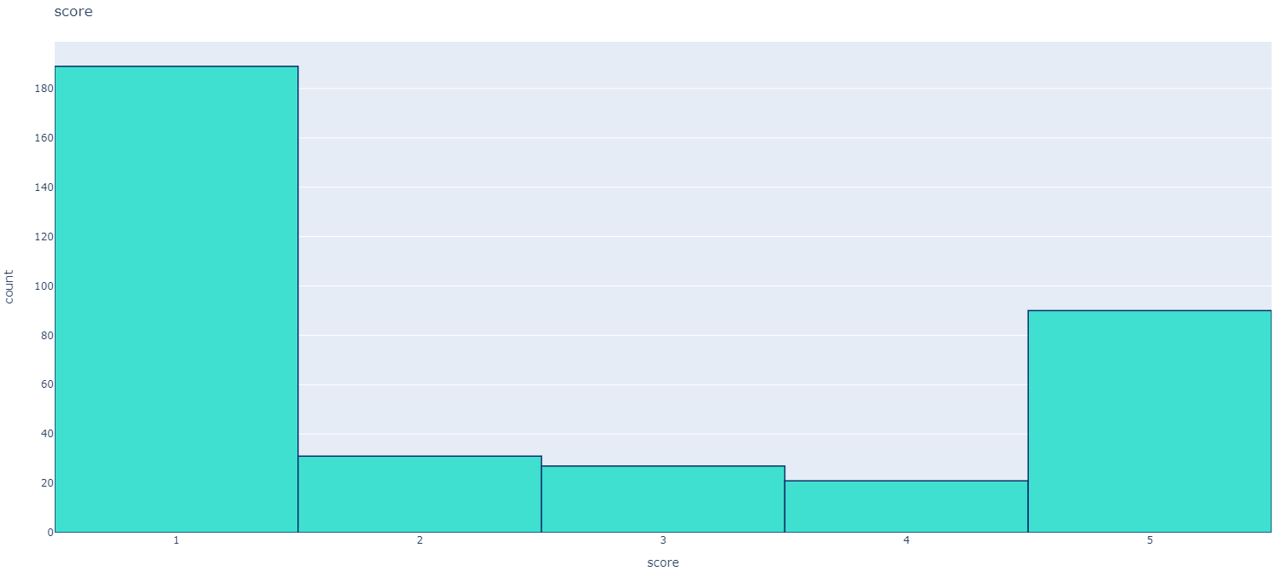
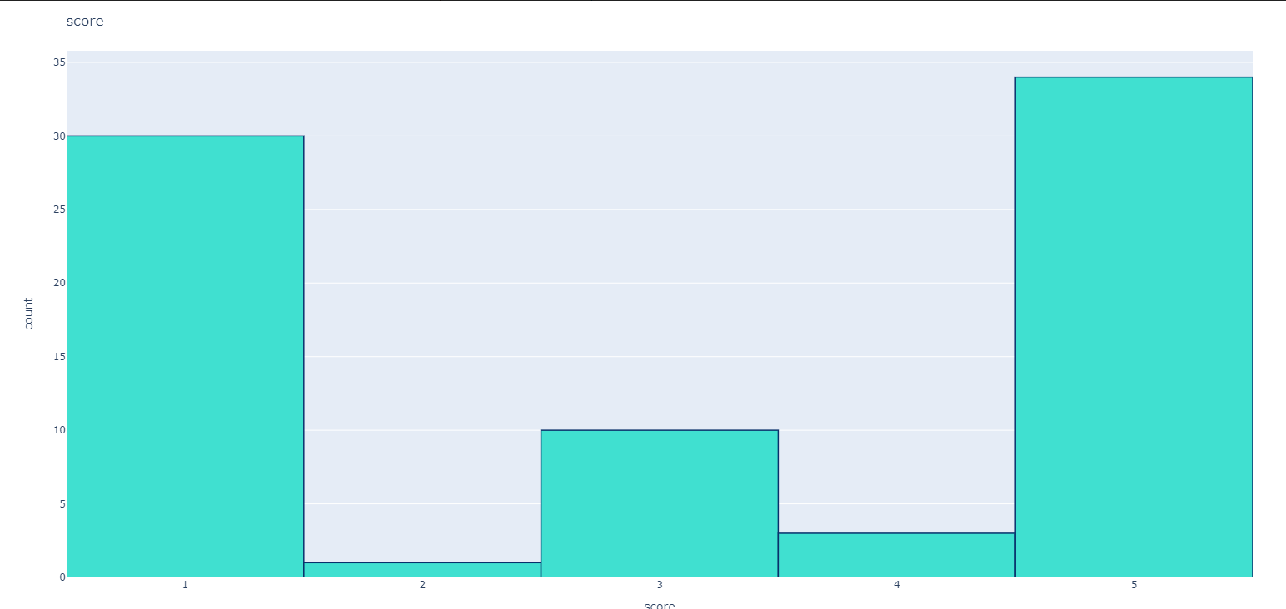
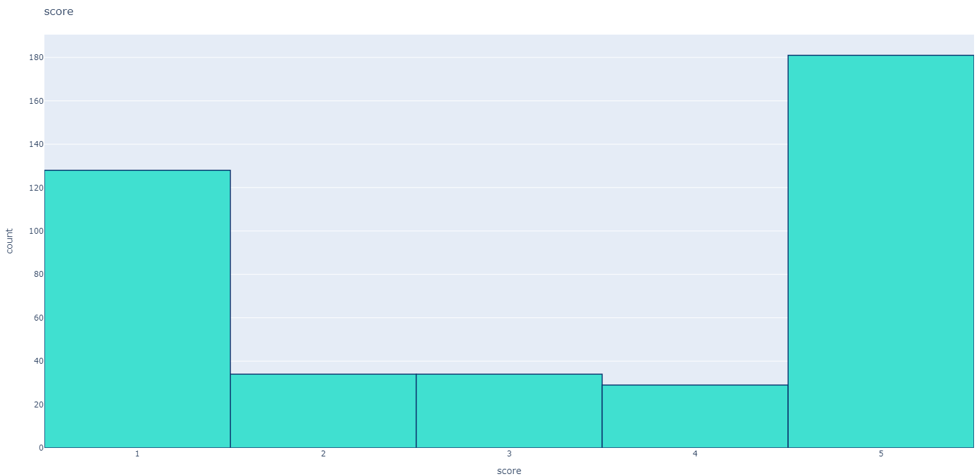
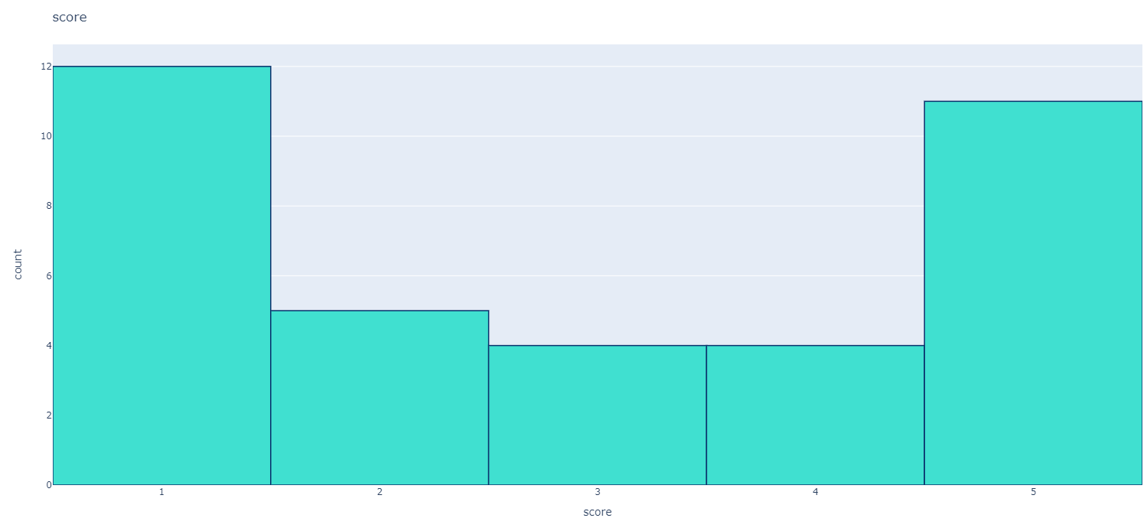
App Score Sentiment (Cont.)
CA Notify
MI Covid Alert
WI Exposure Notification
Covid Watch Arizona
Slow Covid NC

Slide 14
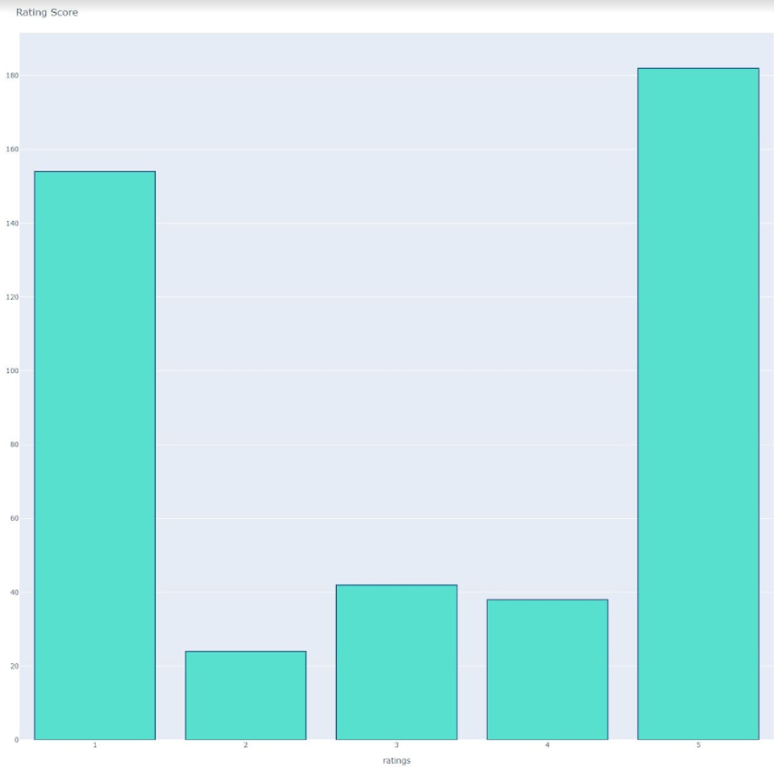
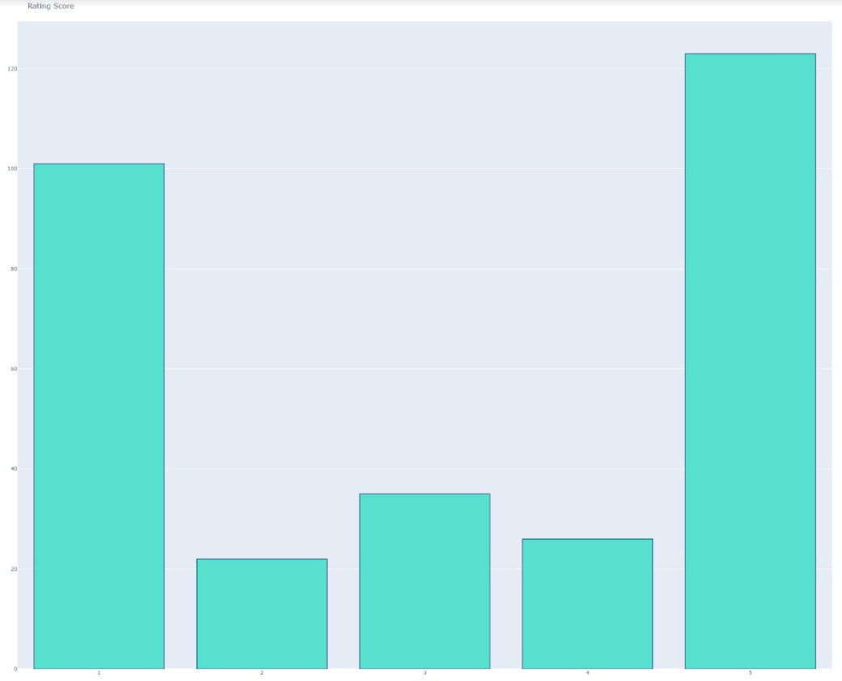
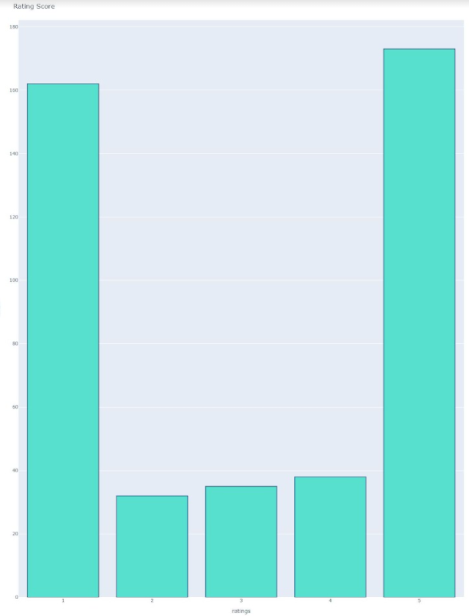
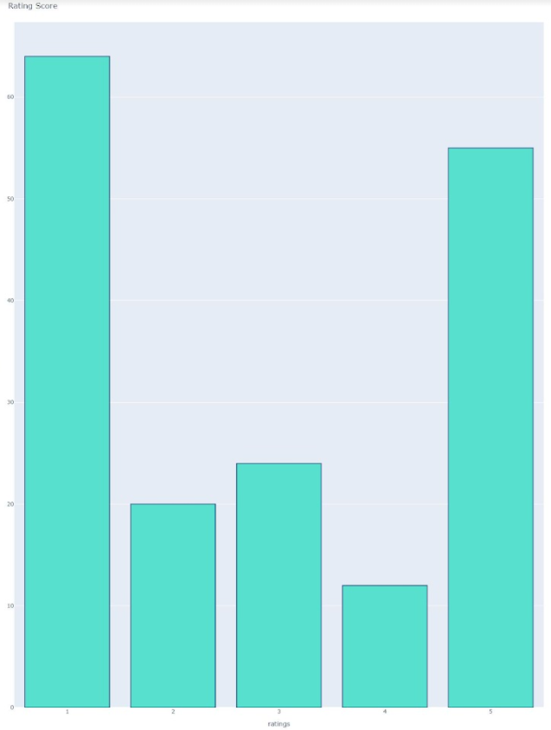
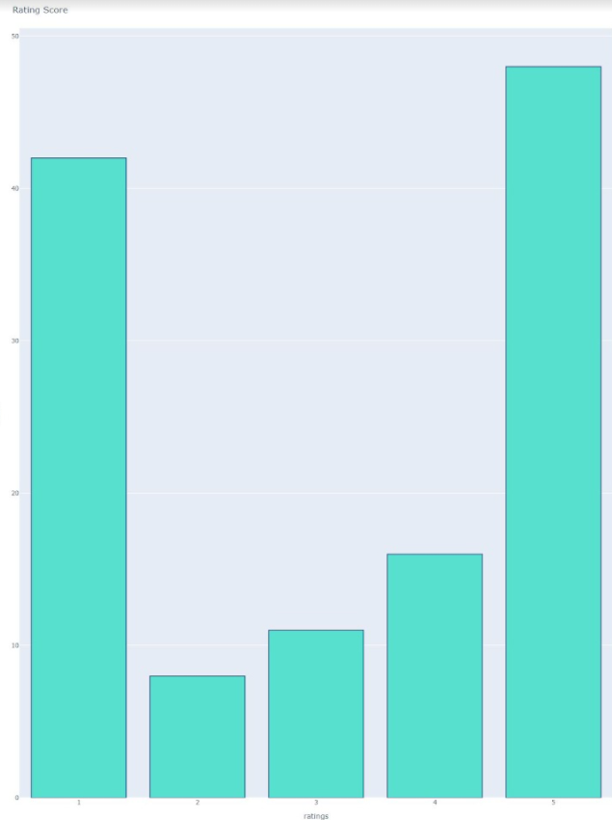
App Score Sentiment (Cont.)
Covid Alert NY
Covid Alert NJ
Covid Alert PA
MD Covid Alert
Covid Alert CT

Slide 15
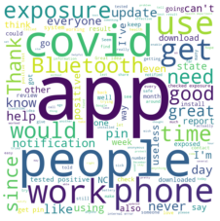
Word Cloud Sentiment
import nltk
import re
nltk.download('stopwords')
from nltk.corpus import stopwords
from wordcloud import WordCloud
# Create stopword list:
stopwords = set(stopwords.words('english'))
stopwords.update(["br", "href"])
textt = " ".join(review for review in df.content.astype(str))
wordcloud = WordCloud(width = 800, height = 800,
background_color ='white',
stopwords = stopwords,
min_font_size = 10).generate(textt)
plt.imshow(wordcloud, interpolation='bilinear')
plt.axis("off")
plt.savefig('SlowCovidNC.png')
plt.show()
...
Ex.
# split df - positive and negative sentiment:
positive = df[df['sentiment'] == 1]
negative = df[df['sentiment'] == -1]

Slide 16
Word Cloud Sentiment (Cont.)
Positive
Negative
import nltk
import re
nltk.download('stopwords')
from nltk.corpus import stopwords
from wordcloud import WordCloud
stopwords = set(stopwords.words('english'))
stopwords.update(["br", "href","good","great"])
## good and great removed because they were included in negative sentiment
pos = " ".join(review for review in positive.content)
wordcloud2 = WordCloud(stopwords=stopwords).generate(pos)
plt.imshow(wordcloud2, interpolation='bilinear')
plt.axis("off")
plt.show()
neg = " ".join(review for review in negative.content)
wordcloud3 = WordCloud(stopwords=stopwords).generate(neg)
plt.imshow(wordcloud3, interpolation='bilinear')
plt.axis("off")
plt.savefig('SlowCovidNC Negative.png')
plt.show()

Slide 17
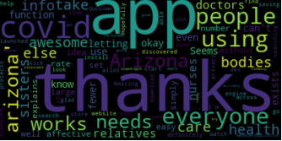
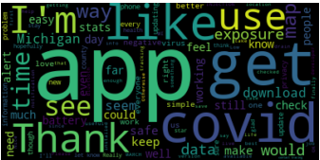
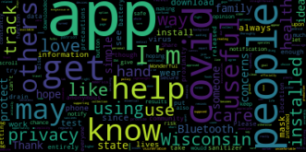
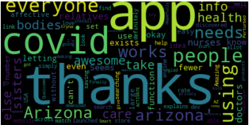
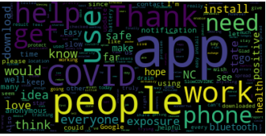
Positive Sentiment
CA Notify
MI Covid Alert
WI Exposure Notification
Covid Watch Arizona
Slow Covid NC

Slide 18
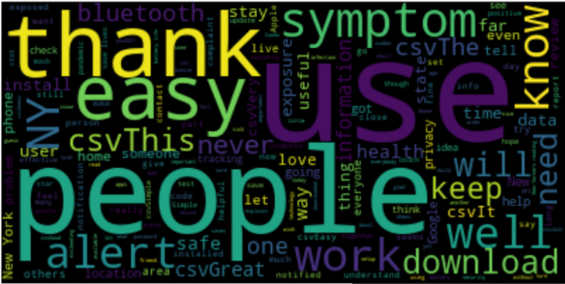
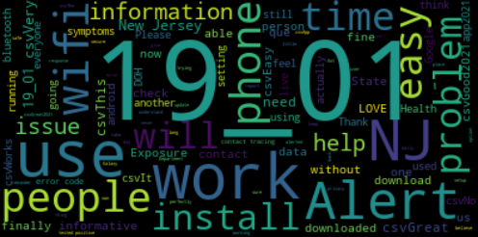
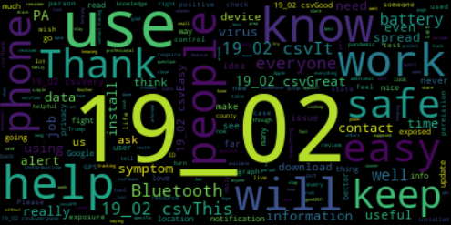
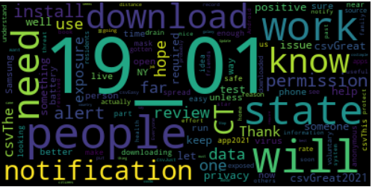
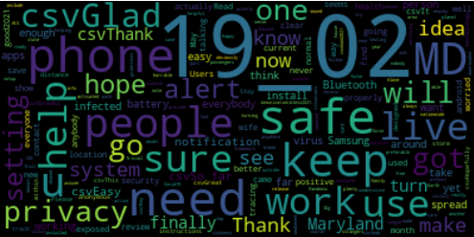
Positive Sentiment (Cont.)
Covid Alert NY
Covid Alert NJ
Covid Alert PA
Covid Alert CT
MD Covid Alert

Slide 19
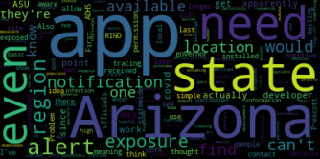
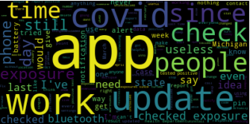
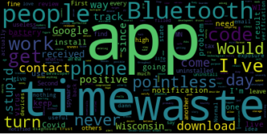
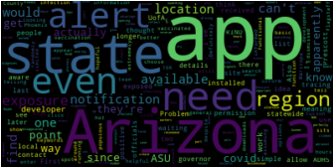
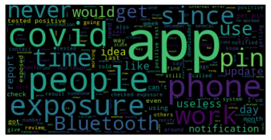
Negative Sentiment
CA Notify
MI Covid Alert
WI Exposure Notification
Covid Watch Arizona
Slow Covid NC

Slide 20
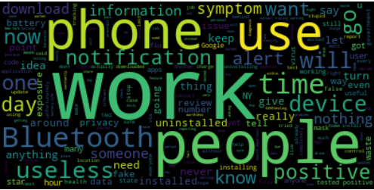
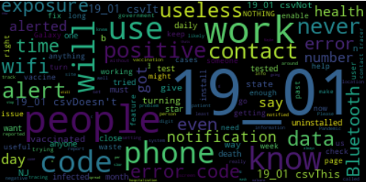
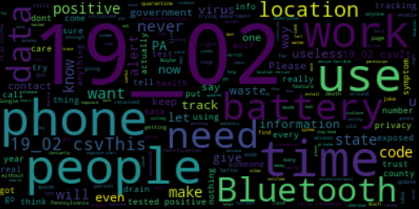
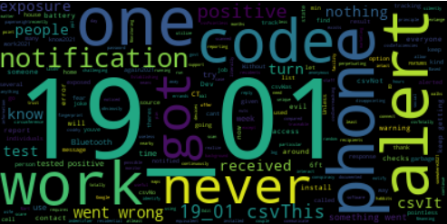
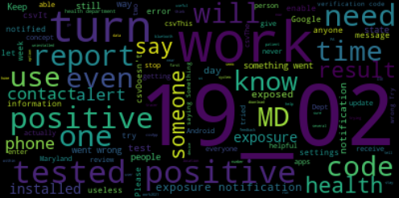
Negative Sentiment (Cont.)
Covid Alert NY
Covid Alert NJ
Covid Alert PA
Covid Alert CT
MD Covid Alert

Slide 21
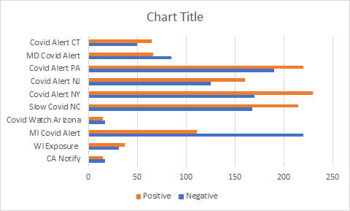
Product Sentiment

Slide 22
Logistic Regression Code
# random split train and test data
import numpy as np
index = df.index
df['random_number'] = np.random.randn(len(index))
train = df[df['random_number'] <= 0.8]
test = df[df['random_number'] > 0.8]
# count vectorizer:
from sklearn.feature_extraction.text import CountVectorizer
vectorizer = CountVectorizer(token_pattern=r'\b\w+\b')
train_matrix = vectorizer.fit_transform(train['content'])
test_matrix = vectorizer.transform(test['content'])

Slide 23
Logistic Regression (Cont.)
# find accuracy, precision, recall:
import numpy as np
from sklearn.metrics import confusion_matrix,classification_report
new = np.asarray(y_test)
confusion_matrix(predictions,y_test)
print(classification_report(predictions,y_test))
# Logistic Regression
from sklearn.linear_model import LogisticRegression
lr = LogisticRegression()
X_train = train_matrix
X_test = test_matrix
y_train = train['sentiment']
y_test = test['sentiment']
lr.fit(X_train,y_train)
predictions = lr.predict(X_test)

Slide 24
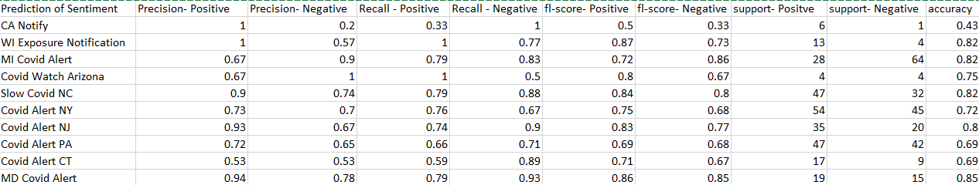
Prediction of Sentiment

Slide 25
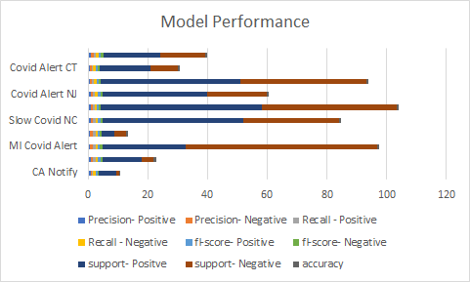
Prediction of Sentiment (Cont.)

Slide 26
Conclusion
In conclusion, the research we conducted led us to fruitful results. With the help of sentiment analysis and logistic regression we were able to find out and predict the reviews of the tracing apps.
Although we were met with a obstruction at the crossroads regarding the lack of open/filtered ports we quickly decided to change our approach to the information we gathered. Thankfully we were able to produce some results from our earlier research, I think that we were able to create a conclusive project.
If we had more time we definitely would have tried to implement more methods in project such as the K-NN algorithm, and Neural Networks.

